Slide 1

Multiprocessor Synchronization
CSCI 176
Concurrent Queues and Stacks
Lecture 16
November 2024
Maurice Herlihy
Brown University

Slide 2
The Five-Fold Path
Coarse-grained locking
Fine-grained locking
Optimistic synchronization
Lazy synchronization
Lock-free synchronization
2
Notes:
2
We saw 4 approaches to concurrent data structure design.

Slide 3
Another Fundamental Problem
We told you about linked lists
Coming up, stacks & queues
3
Notes:
3
We have already talked about concurrent lists, and today we look at another ubiquitous data structure: queues. Queues provide enqueue and dequeue methods and they are used to route requests from one place to another. For example, a web site might queue up requests for pages, for disk writes, for credit card validations and so on.

Slide 4
Queues & Stacks
pool of items
4
Notes:
4

Slide 5
Queues
deq()/
enq( )
Total order:
First in
First out
5
Notes:
5

Slide 6
Stacks
pop()/
Total order:
Last in
First out
push( )
6
Notes:
6

Slide 7
Bounded
Fixed capacity
Good when resources an issue
7
Notes:
7
When designing a pool interface, one choice is whether the make the pool bounded or unbounded. A bounded pool has a fixed capacity (maximum number of objects it holds). Bounded pools are useful when resources are an issue. For example, if you are concerned that the producers will get too far ahead of the consumers, you should bound the pool. An unbounded pool, by contrast, holds an unbounded number of objects.

Slide 8
Unbounded
Unlimited capacity
Often more convenient
…
8
Notes:
8
When designing a pool interface, one choice is whether the make the pool bounded or unbounded. A bounded pool has a fixed capacity (maximum number of objects it holds). Bounded pools are useful when resources are an issue. For example, if you are concerned that the producers will get too far ahead of the consumers, you should bound the pool. An unbounded pool, by contrast, holds an unbounded number of objects.

Slide 9
Blocking
zzz …
Block on attempt to remove from empty stack or queue
Notes:
When you try to dequeue from an empty queue, it makes sense to block if you don’t have anything else to do.

Slide 10
Blocking
zzz …
Block on attempt to add to full bounded stack or queue
Notes:
Same is true for adding to a full bounded stack or queue.

Slide 11
Non-Blocking
Ouch!
Throw exception on attempt to remove from empty stack or queue
Notes:
The alternative is to throw an exception. This choice makes sense when the thread can profitably turn its attention to other activities.

Slide 12
This Lecture
Queue
Bounded, blocking, lock-based
Unbounded, non-blocking, lock-free
Stack
Unbounded, non-blocking lock-free
Elimination-backoff algorithm
12
Notes:
12
In this lecture we are going to look at two alternative highly-concurrent queue implementations. The first is a bounded, blocking, lock-based queue. This implementation uses a combination of techniques due to Doug Lea and to Maged Michael and Michael Scott. The second implementation is an unbounded, non-blocking, lock-free implementation due to Michael and Scott. We will then continue to examine the design of concurrent stacks, show Treiber’s lock-free stack and then how one can add parallelism to a stack through a technique called elimination.

Slide 13
Queue: Concurrency
enq(x)
y=deq()
tail
head
work at different ends of the object
13
Notes:
13
Making a queue concurrent is quite a challenge. Very informally, it seems that it should be OK for one thread to enqueue an item at one end of the queue while another thread dequeues an item from the other end, since they are working on disjoint parts of the data structure. Does that kind of concurrency seem easy to realize? (Answer: next slide)

Slide 14
Concurrency
tail
head
Challenge: what if the queue is empty or full?
14
Notes:
14
Concurrent enqueue and dequeue calls should in principle be able to proceed without interference, but it gets tricky when the queue is nearly full or empty, because then one method call should affect the other. The problem is that whether the two method calls interfere (that is, need to synchronize) depends on the dynamic state of the queue. In pretty much all of the other kinds of synchronization we considered, whether or not method calls needed to synchronize was determined statically (say read/write locks) or was unlikely to change very often (resizable hash tables).

Slide 15
Bounded Queue
head
tail
Sentinel
15
Notes:
15
Let’s use a list-based structure, although arrays would also work. We start out with head and tail fields that point to the first and last entries in the list. The first Node in the list is a sentinel Node whose value field is meaningless. The sentinel acts as a placeholder.

Slide 16
Bounded Queue
head
tail
First actual item
16
Notes:
16
When we add actual items to the queue, we will hang them off the sentinel Node at the head.

Slide 17
Bounded Queue
head
tail
deqLock
Lock out other deq() calls
17
Notes:
17
The most straightforward way to allow concurrent enq and deq calls is to use one lock at each end of the queue. To make sure that only one dequeuer is accessing the queue at a time, we introduce a dequeue lock field. Could we get the same effect just by locking the tail Node? (Answer: there’s a race condition between when a thread reads the tail field and when it acquires the lock. Another thread might have enqueued something in that interval. Of course you could check after you acquire the lock that the tail pointer hadn’t changed, but that seems needlessly complicated.)

Slide 18
Bounded Queue
head
tail
deqLock
Lock out other deq() calls
enqLock
Lock out other enq() calls
18
Notes:
18
In the same way, we introduce an explicit enqLock field to ensure that only one enqueuer can be accessing the queue at a time. Would it work if we replaced the enqLock by a lock on the first sentinel Node? (Answer: Yes, it would because the value of the head field never changes. Nevertheless we use an enqLock field to be symmetric with the deqLock.)

Slide 19
Not Done Yet
head
tail
deqLock
enqLock
Need to tell whether queue is full or empty
19
Notes:
19
Let’s add another size field, which will keep track of the number of items.

Slide 20
Not Done Yet
head
tail
deqLock
enqLock
1
Capacity (max size) is 8 items
20
Notes:
20
Let’s add another size field, which will keep track of the number of items.

Slide 21
Not Done Yet
head
tail
deqLock
enqLock
1
Incremented by enq()
Decremented by deq()
21
Notes:
21
Let’s add another size field, which will keep track of the number of items.

Slide 22
Enqueuer
head
tail
deqLock
enqLock
Lock enqLock
1
22
Notes:
22
Let’s walk through a very simple implementation. A thread that wants to enqueue an item first acquires the enqLock. At this point, we know there are no other enq calls in progress.

Slide 23
Enqueuer
head
tail
deqLock
enqLock
Read size
1
OK
23
Notes:
23
Next, the thread reads the size. What do we know about how this field behaves when the thread is holding the enqLock? (Answer: it can only decrease. Dequeuers can decrement the counter, but all the enqueuers are locked out.) If the enqueuing thread sees a value less than 8 for size, it can proceed.

Slide 24
Enqueuer
head
tail
deqLock
No need to lock tail
enqLock
1
24
Notes:
24
The thread does not need to lock tail Node before appending a new Node. Clearly, there is no conflict with another enqueuer and we will see a clever way to avoid conflict with a dequeuer.

Slide 25
Enqueuer
head
tail
deqLock
enqLock
Enqueue Node
size
1
25
Notes:
25
Still holding the enqLock, the thread redirects both the tail Node’s next field and the queue’s tail field to point to the new Node.

Slide 26
Enqueuer
head
tail
deqLock
enqLock
Enqueue Node
size
2
1
getAndincrement()
26
Notes:
26
Still holding the enqLock, the thread calls getAndIncrement() to increase the size. Remember that we know the number is less than 8, although we don’t know exactly what it is now. Why can’t we release the enqLock before the increment? (Answer: because then other enqueuers won’t know when they have run out of size.)

Slide 27
Enqueuer
head
tail
deqLock
enqLock
size
Release lock
8
2
27
Notes:
27
Finally, we can release the enqLock and return.

Slide 28
Enqueuer
head
tail
deqLock
enqLock
If queue was empty, notify waiting dequeuers
size
2
28
Notes:
28
There is one more issue to consider. If the queue was empty, then one or more dequeuers may be waiting for an item to appear. If the dequeuer is spinning then we don’t need to do anything, but if the dequeuers are suspended in the usual Java way, then we need to notify them. There are many ways to do this, but for simplicity we will not try to be clever, and simply require any enqueuer who puts an item in an empty queue to acquire the deqLock and notify any waiting threads.
TALKING POINT; Notice that Java requires you to acquire the lock for an object before you can notify threads waiting to reacquire that lock. Not clear if this design is a good idea. Does it invite deadlock? Discuss.

Slide 29
Unsuccessful Enqueuer
…
head
tail
deqLock
enqLock
Read size
size
8
enqLock.await()
29
Notes:
29
Let’s rewind and consider what happens if the enqueuing thread found the queue full. Suppose the threads synchronize by blocking, say using the Java wait() method. In this case, the thread can wait() on the enqLock, provided the first dequeuer to remove an item notifies the waiting thread.
An alternative is for the enqueuer to spin waiting for the number of size to be less than 8. In general, it is a dangerous practice to spin while holding a lock. It so happens that it works in this case, provided the dequeuer also spins when the queue is empty. Spinning here is cache-friendly, since the thread is spinning on a locally-cached value, and stops spinning as soon as the field value changes.

Slide 30
Dequeuer
head
tail
deqLock
enqLock
Lock deqLock
size
2
30
Notes:
30
Now let’s walk through a similar deq() implementation. The code is similar, but not at all identical. As a first step, the dequeuer thread acquires the deqLock.

Slide 31
Dequeuer
head
tail
deqLock
enqLock
Read sentinel’s next field
size
2
OK
31
Notes:
31
Next, the thread reads the sentinel node’s next field. If that field is non-null, the queue is non-empty. Once the enqueuer sees a non-empty next field, that field will remain that way. Why? (ANSWER: the deq() code, which we have seen, changes null references to non-null, but never changes a non-null reference). The enqueuers are all locked out, and no dequeuer will modify a non-null field. There is no need to lock the Node itself, because it is implicitly protected by the enqLock.

Slide 32
Dequeuer
head
tail
deqLock
enqLock
Read value
size
2
32
Notes:
32
Next, the thread reads the first Node’s value, and stores it in a local variable.

Slide 33
Dequeuer
Make first Node new sentinel
head
tail
deqLock
enqLock
size
2
33
Notes:
33
The thread then makes the first Node the new sentinel, and discards the old sentinel. This step may seem obvious, but, in fact, it is enormously clever. If we had tried to physically remove the Node, we would soon become bogged down in quagmire of complications. Instead, we discard the prior sentinel, and transform the prior first real Node into a sentinel. Brilliant.

Slide 34
Dequeuer
head
tail
deqLock
enqLock
Decrement size
size
1
34
Notes:
34
Finally, we decrement the number of size. By contrast with enqueuers, we do not need to hold the lock while we decrement the size. Why? (Answer: we had to hold the lock while enqueuing to prevent lots of enqueuers from proceeding without noticing that the capacity had been exceeded. Dequeuers will notice the queue is empty when they observe that the sentinel’s next field is null.)

Slide 35
Dequeuer
head
tail
deqLock
enqLock
size
1
Release deqLock
35
Notes:
35
Next we can release the deqLock
ck.

Slide 36
Unsuccessful Dequeuer
head
tail
deqLock
Read sentinel’s next field
enqLock
size
0
deqLock.await()
36
Notes:
36
If the dequeuer observes that the sentinel’s next field is null, then it must wait for something to be enqueued. As with the dequeuer, the simplest approach is just to wait() on the deqLock, with the understanding that any enqueuer who makes the queue non-empty will notify any waiting threads. Spinning works too, even though the thread is holding a lock. Clearly, mixing the two strategies will not work: if a dequeuer spins while holding the deq lock and an enqueuer tries to acquire the deq lock to notify waiting threads, then a deadlock ensues.

Slide 37
Bounded Queue
public class BoundedQueue<T> {
ReentrantLock enqLock, deqLock;
Condition notEmptyCondition, notFullCondition;
AtomicInteger size;
Node head;
Node tail;
int capacity;
enqLock = new ReentrantLock();
notFullCondition = enqLock.newCondition();
deqLock = new ReentrantLock();
notEmptyCondition = deqLock.newCondition();
}
37
Notes:
37

Slide 38
Bounded Queue
public class BoundedQueue<T> {
ReentrantLock enqLock, deqLock;
Condition notEmptyCondition, notFullCondition;
AtomicInteger size;
Node head;
Node tail;
int capacity;
enqLock = new ReentrantLock();
notFullCondition = enqLock.newCondition();
deqLock = new ReentrantLock();
notEmptyCondition = deqLock.newCondition();
}
enq & deq locks
38
Notes:
38

Slide 39
Bounded Queue Fields
public class BoundedQueue<T> {
ReentrantLock enqLock, deqLock;
Condition notEmptyCondition, notFullCondition;
AtomicInteger size;
Node head;
Node tail;
int capacity;
enqLock = new ReentrantLock();
notFullCondition = enqLock.newCondition();
deqLock = new ReentrantLock();
notEmptyCondition = deqLock.newCondition();
}
enqLock’s associated condition
39
Notes:
39

Slide 40
Bounded Queue Fields
public class BoundedQueue<T> {
ReentrantLock enqLock, deqLock;
Condition notEmptyCondition, notFullCondition;
AtomicInteger size;
Node head;
Node tail;
int capacity;
enqLock = new ReentrantLock();
notFullCondition = enqLock.newCondition();
deqLock = new ReentrantLock();
notEmptyCondition = deqLock.newCondition();
}
size: 0 to capacity
40
Notes:
40

Slide 41
Bounded Queue Fields
public class BoundedQueue<T> {
ReentrantLock enqLock, deqLock;
Condition notEmptyCondition, notFullCondition;
AtomicInteger size;
Node head;
Node tail;
int capacity;
enqLock = new ReentrantLock();
notFullCondition = enqLock.newCondition();
deqLock = new ReentrantLock();
notEmptyCondition = deqLock.newCondition();
}
Head and Tail
41
Notes:
41

Slide 42
Enq Method Part One
public void enq(T x) {
boolean mustWakeDequeuers = false;
enqLock.lock();
try {
while (size.get() == Capacity)
notFullCondition.await();
Node e = new Node(x);
tail.next = e;
tail = tail.next;
if (size.getAndIncrement() == 0)
mustWakeDequeuers = true;
} finally {
enqLock.unlock();
}
…
}
42
Notes:
42
A remarkable aspect of this queue implementation is that the methods are subtle, but they fit on a single slide.
The \mEnq{} method (Figure~\ref{figure:boundedQueue:enq})
works as follows.
A thread acquires the \fEnqLock{}
(Line \ref{line:bounded:lock}),
and repeatedly reads the \fsize{} field
(Line \ref{line:bounded:size}).
While that field
is zero, the queue is full, and the enqueuer must wait until a
dequeuer makes room.
The enqueuer waits by waiting on the \fNotFullCondition{} field
(Line \ref{line:bounded:notfull}),
which releases the enqueue lock temporarily,
and blocks until the condition is signaled.
Each time the thread awakens
(Line \ref{line:bounded:notfull}),
it checks whether the
\fsize{} field is positive (that is, the queue is not empty)
and if not, goes back to sleep.

Slide 43
Enq Method Part One
public void enq(T x) {
boolean mustWakeDequeuers = false;
enqLock.lock();
try {
while (size.get() == Capacity)
notFullCondition.await();
Node e = new Node(x);
tail.next = e;
tail = tail.next;
if (size.getAndIncrement() == 0)
mustWakeDequeuers = true;
} finally {
enqLock.unlock();
}
…
}
Lock and unlock enq lock
43
Notes:
43
A remarkable aspect of this queue implementation is that the methods are subtle, but they fit on a single slide.
The \mEnq{} method (Figure~\ref{figure:boundedQueue:enq})
works as follows.
A thread acquires the \fEnqLock{}
(Line \ref{line:bounded:lock}),
and repeatedly reads the \fsize{} field
(Line \ref{line:bounded:size}).
While that field
is zero, the queue is full, and the enqueuer must wait until a
dequeuer makes room.
The enqueuer waits by waiting on the \fNotFullCondition{} field
(Line \ref{line:bounded:notfull}),
which releases the enqueue lock temporarily,
and blocks until the condition is signaled.
Each time the thread awakens
(Line \ref{line:bounded:notfull}),
it checks whether the
\fsize{} field is positive (that is, the queue is not empty)
and if not, goes back to sleep.

Slide 44
Enq Method Part One
public void enq(T x) {
boolean mustWakeDequeuers = false;
enqLock.lock();
try {
while (size.get() == Capacity)
notFullCondition.await();
Node e = new Node(x);
tail.next = e;
tail = tail.next;
if (size.getAndIncrement() == 0)
mustWakeDequeuers = true;
} finally {
enqLock.unlock();
}
…
}
Wait while queue is full …
44
Notes:
44
Once the number of size exceeds zero, however, the enqueuer may proceed.
Note that once the enqueuer observes a positive number of size,
then while the enqueue is in progress no other thread can cause the number of
size to fall back to zero,
because all the other enqueuers are locked out,
and a concurrent dequeuer can only increase the number of size.
We must check carefully that this implementation does not suffer
from a ``lost-wakeup'' bug. Care is needed because an enqueuer
encounters a full queue in two steps: first, it sees that
\fsize{} is zero, and second, it waits on the
\fNotFullCondition{} condition until there is room in the queue.
When a dequeuer changes the queue from full to not-full, it
acquires \fEnqLock{} and signals the \fNotFullCondition{}
condition. Even though the \fsize{} field is not protected by
the \fEnqLock{}, the dequeuer acquires the \fEnqLock{} before it
signals the condition, so the dequeuer cannot signal between the
enqueuer's two steps.

Slide 45
Enq Method Part One
public void enq(T x) {
boolean mustWakeDequeuers = false;
enqLock.lock();
try {
while (size.get() == Capacity)
notFullCondition.await();
Node e = new Node(x);
tail.next = e;
tail = tail.next;
if (size.getAndIncrement() == 0)
mustWakeDequeuers = true;
} finally {
enqLock.unlock();
}
…
}
when await() returns, queue might still be full!
45
Notes:
45
Once the number of size exceeds zero, however, the enqueuer may proceed.
Note that once the enqueuer observes a positive number of size,
then while the enqueue is in progress no other thread can cause the number of
size to fall back to zero,
because all the other enqueuers are locked out,
and a concurrent dequeuer can only increase the number of size.
We must check carefully that this implementation does not suffer
from a ``lost-wakeup'' bug. Care is needed because an enqueuer
encounters a full queue in two steps: first, it sees that
\fsize{} is zero, and second, it waits on the
\fNotFullCondition{} condition until there is room in the queue.
When a dequeuer changes the queue from full to not-full, it
acquires \fEnqLock{} and signals the \fNotFullCondition{}
condition. Even though the \fsize{} field is not protected by
the \fEnqLock{}, the dequeuer acquires the \fEnqLock{} before it
signals the condition, so the dequeuer cannot signal between the
enqueuer's two steps.

Slide 46
Be Afraid
public void enq(T x) {
boolean mustWakeDequeuers = false;
enqLock.lock();
try {
while (size.get() == Capacity)
notFullCondition.await();
Node e = new Node(x);
tail.next = e;
tail = tail.next;
if (size.getAndIncrement() == 0)
mustWakeDequeuers = true;
} finally {
enqLock.unlock();
}
…
}
After the loop: how do we know the queue won’t become full again?
46
Notes:
46
Once the size is below the capacity, however, the enqueuer may proceed. Once the enqueuer observes the size is less than capacity,
then while the enqueue is in progress no other thread can cause size to become capacity, because all the other enqueuers are locked out,
and a concurrent dequeuer can only decrease the size.
We must check carefully that this implementation does not suffer
from a ``lost-wakeup'' bug. Care is needed because an enqueuer
encounters a full queue in two steps: first, it sees that
\fsize{} is zero, and second, it waits on the
\fNotFullCondition{} condition until there is room in the queue.
When a dequeuer changes the queue from full to not-full, it
acquires \fEnqLock{} and signals the \fNotFullCondition{}
condition. Even though the \fsize{} field is not protected by
the \fEnqLock{}, the dequeuer acquires the \fEnqLock{} before it
signals the condition, so the dequeuer cannot signal between the
enqueuer's two steps.

Slide 47
Enq Method Part One
public void enq(T x) {
boolean mustWakeDequeuers = false;
enqLock.lock();
try {
while (size.get() == Capacity)
notFullCondition.await();
Node e = new Node(x);
tail.next = e;
tail = tail.next;
if (size.getAndIncrement() == 0)
mustWakeDequeuers = true;
} finally {
enqLock.unlock();
}
…
}
Add new node
47
Notes:
47

Slide 48
Enq Method Part One
public void enq(T x) {
boolean mustWakeDequeuers = false;
enqLock.lock();
try {
while (size.get() == Capacity)
notFullCondition.await();
Node e = new Node(x);
tail.next = e;
tail = tail.next;
if (size.getAndIncrement() == 0)
mustWakeDequeuers = true;
} finally {
enqLock.unlock();
}
…
}
If queue was empty, remember to wake any sleeping dequeuers
48
Notes:
48

Slide 49
Enq Method Part Two
public void enq(T x) {
…
if (mustWakeDequeuers) {
deqLock.lock();
try {
notEmptyCondition.signalAll();
} finally {
deqLock.unlock();
}
}
}
49
Notes:
49
Why do we hold the lock during signaling. Well, as explained by David Holmes, a top java concurrency programmer/designer, once you wait() for a condition there is an expectation that some other thread will cause the condition to become true and notify you of that fact.
The notification must only occur before the waiter sees the condition
doesn't hold (queue is full), or after the waiter enters the actual wait, otherwise the
notification won't be seen. In our case these are the lines
while (size.get() == capacity)
notFullCondition.await();
Hence the notifying thread has to hold the same
lock while it sets the condition and performs the notification.
Now strictly speaking in terms of synchronization correctness it is not
necessary to hold a lock when you do a condition signal - as long as you
signal AFTER changing the state. However Java requires that you do hold the
lock - why? Because otherwise people would forget to hold the lock when
setting the condition and the program would be incorrect. The situation
where doing a notification/signal without holding the lock is beneficial
only in rare circumstances as a potential performance optimization. This is
an example of the language designers choosing what's best for the majority
of programmers.

Slide 50
Enq Method Part Two
public void enq(T x) {
…
if (mustWakeDequeuers) {
deqLock.lock();
try {
notEmptyCondition.signalAll();
} finally {
deqLock.unlock();
}
}
}
Should I wake up any sleeping dequeuers?
50
Notes:
50
Why do we hold the lock during signaling. Well, as explained by David Holmes, a top java concurrency programmer/designer, once you wait() for a condition there is an expectation that some other thread will cause the condition to become true and notify you of that fact.
The notification must only occur before the waiter sees the condition
doesn't hold (queue is full), or after the waiter enters the actual wait, otherwise the
notification won't be seen. In our case these are the lines
while (size.get() == capacity)
notFullCondition.await();
Hence the notifying thread has to hold the same
lock while it sets the condition and performs the notification.
Now strictly speaking in terms of synchronization correctness it is not
necessary to hold a lock when you do a condition signal - as long as you
signal AFTER changing the state. However Java requires that you do hold the
lock - why? Because otherwise people would forget to hold the lock when
setting the condition and the program would be incorrect. The situation
where doing a notification/signal without holding the lock is beneficial
only in rare circumstances as a potential performance optimization. This is
an example of the language designers choosing what's best for the majority
of programmers.

Slide 51
Enq Method Part Two
public void enq(T x) {
…
if (mustWakeDequeuers) {
deqLock.lock();
try {
notEmptyCondition.signalAll();
} finally {
deqLock.unlock();
}
}
}
Lock and unlock deq lock
51
Notes:
51
The deq() method is symmetric.

Slide 52
Enq Method Part Two
public void enq(T x) {
…
if (mustWakeDequeuers) {
deqLock.lock();
try {
notEmptyCondition.signalAll();
} finally {
deqLock.unlock();
}
}
}
Signal dequeuers that queue is no longer empty
52
Notes:
52

Slide 53
The enq() & deq() Methods
Share no locks (that’s good!)
But do share an atomic counter
Accessed on every method call (not good)
53
Notes:
53
The key insight is that the enqueuer only decrements the counter, and really cares only whether or not the counter value is zero. Symmetrically, the dequeuer cares only whether or not the counter value is the queue capacity.
NB: the deq() method does not explicitly check the size field, but relies on testing the sentinel Node’s next field. Same thing.

Slide 54
Split the Counter
The enq() method
Increments only
Cares only if value is capacity
The deq() method
Decrements only
Cares only if value is zero
54
Notes:
54
The key insight is that the enqueuer only decrements the counter, and really cares only whether or not the counter value is zero. Symmetrically, the dequeuer cares only whether or not the counter value is the queue capacity.
NB: the deq() method does not explicitly check the size field, but relies on testing the sentinel Node’s next field. Same thing.

Slide 55
Split Counter
Enqueuer increments enqSize
Dequeuer increments deqSize
When enqueuer hits capacity
  Locks deqLock
  Sets size = enqSize - deqSize
Intermittent synchronization
  Not with each method call
  Need both locks! (careful, why?)
55
Notes:
55
Let’s summarize. We split the size field in to two parts. The enqueuer decrements the enqSize field, and the dequeuer increments the deqSize field. When the enqueuer discovers that its field has reached capacity, then it tries to recalculate the size. Why do this? It replaces synchronization with each method call with sporadic, intermittent synchronization. As a practical matter, an enqueuer that runs out of space needs to acquire the dequeue lock (why?) (ANSWER: to prevent the dequeuer from decrementing the size at the same time we are trying to copy it).
WARNING: Any time you try to acquire a lock while holding another, your ears should prick up (alt: your spider-sense should tingle) because you are just asking for a deadlock. So far, no danger, because all of the methods seen so far never hold more than one lock at a time.

Slide 56
A Lock-Free Queue
head
tail
Sentinel
56
Notes:
56
Now we consider an alternative approach that does not use locks. The Lock-free queue is due to Maged Michael & Michael Scott
HUMOR: this construction is due to Maged Michael and Michael Scott. Everyone cites it as Michael Scott, which means that many people (unjustly) think that Michael Scott invented it. The moral is, make sure that your last name is not the same as your advisor’s first name.
Here too we use a list-based structure. Since the queue is unbounded, arrays would be awkward. As before, We start out with head and tail fields that point to the first and last entries in the list. The first Node in the list is a sentinel Node whose value field is meaningless. The sentinel acts as a placeholder.

Slide 57
Compare and Set
CAS
57
Notes:
57
One difference from the lock-based queue is that we use CAS to manipulate the next fields of entries. Before, we did all our synchronization on designed fields in the queue itself, but here we must synchronize on Node fields as well.

Slide 58
Enqueue
head
tail
enq( )
58
Notes:
58
As a first step, the enqueuer calls CAS to sent the tail Node’s next field to the new Node.

Slide 59
Enqueue
head
tail
59
Notes:
59
As a first step, the enqueuer calls CAS to sent the tail Node’s next field to the new Node.

Slide 60
Logical Enqueue
CAS
head
tail
60
Notes:
60
As a first step, the enqueuer calls CAS to sent the tail Node’s next field to the new Node.

Slide 61
Physical Enqueue
head
CAS
tail
61
Notes:
61
Once the tail Node’s next field has been redirected, use CAS to redirect the queue’s tail field to the new Node.

Slide 62
Enqueue
These two steps are not atomic
The tail field refers to either
  Actual last Node (good)
  Penultimate Node (awkward)
Be prepared!
62
Notes:
62
[pe·nul·ti·mate – adjective -- next to the last: “the penultimate scene of the play”]
As you may have guessed, the situation is more complicated than it appears. The enq() method is supposed to be atomic, so how can we get away with implementing it in two non-atomic steps? We can count on the following invariant: the tail field is a reference to (1) actual last Node, or (2) the Node just before the actual last Node.

Slide 63
Enqueue
What do you do if you find
  A trailing tail?
Stop and help fix it
  If tail node has non-null next field
  CAS the queue’s tail field to tail.next
Like the L-F list & the universal construction
63
Notes:
63
Any method call must be prepared to encounter a tail field that is trailing behind the actual tail. This situation is easy to detect. How? (Answer: tail.next not null). How to deal with it? Fix it! Call compareAndSet to set the queue’s tail field to point to the actual last Node in the queuel

Slide 64
When CASs Fail
During logical enqueue?
  Abandon hope, restart
  Still lock-free (why?)
During physical enqueue?
  Ignore it and continue (why?)
64
Notes:
64
What do we do if the CAS calls fail? It matters a lot in which CAS call this happened. In Step One, a failed CAS implies a synchronization conflict with another enq() call. Here, the most sensible approach is to abandon the current effort (panic!) and start over. In Step Two, we can ignore a failed CAS, simply because the failure means that some other thread has executed that step on our behalf.

Slide 65
Dequeuer
head
tail
Read value
65
Notes:
65
Next, the thread reads the first Node’s value, and stores it in a local variable. The slide suggests that the value is nulled out, but in fact there is no need to do so.

Slide 66
Dequeuer
Make first Node new sentinel
CAS
head
tail
66
Notes:
66
The thread then makes the first Node the new sentinel, and discards the old sentinel. This is the clever trick I mentioned earlier that ensures that we do not need to lock the Node itself. We do not physically remove the Node, we just demote it to sentinel.

Slide 67
Memory Reuse?
What do we do with nodes after we dequeue them?
Java: let garbage collector deal?
What if there is no GC (C++)?
What if we prefer not to use it?
67
Notes:
67
Let’s take a brief detour. What do we do with nodes after we remove them from the queue? This is not an issue with the lock-based implementation, but it requires some thought here. In Java, we can just let the garbage collector recycle unused objects. But what if we are operating in an environment where there is no garbage collector, or where we think we can recycle memory more efficiently?

Slide 68
Dequeuer
CAS
head
tail
Can recycle
68
Notes:
68
Let us look at the dequeue method from a different perspective. When we promote the prior first Node to sentinel, what do we do with the old sentinel? Seems like a good candidate for recycling.

Slide 69
Simple Solution
Each thread has a free list of unused queue nodes
Allocate node: pop from list
Free node: push onto list
Deal with corner cases somehow …
69
Notes:
69
The most reasonable solution is to have each thread manage its own pool of unused nodes. When a thread needs a new Node, it pops one from the list. No need for synchronization. When a thread fees A Node, it pushes the newly-freed Node onto the list. What do we do when a thread runs out of nodes? Perhaps we could just malloc() more, or perhaps we can devise a shared pool. Never mind.

Slide 70
Why Recycling is Hard
head
tail
Want to redirect head from gray to red
zzz…
Free pool
70
Notes:
70
Now the green thread goes to sleep, and other threads dequeue the red object and the green object, sending the prior sentinel and prior red Node to the respective free pools of the dequeuing threads.

Slide 71
Both Nodes Reclaimed
head
tail
zzz
Free pool
71
Notes:
71
Despite what you might think, we are perfectly safe, because any thread that tries to CAS the head field must fail, because that field has changed. Now assume that the enough deq() and enq() calls occur such that the original sentinel Node is recycled, and again becomes a sentinel Node for an empty queue.

Slide 72
One Node Recycled
head
tail
Yawn!
Free pool
72
Notes:
72
Now the green thread wakes up. It applies CAS to the queue’s head field ..

Slide 73
Why Recycling is Hard
CAS
head
tail
OK, here I go!
Free pool
73
Notes:
73
Surprise! It works! The problem is that the bit-wise value of the head field is the same as before, even though its meaning has changed. This is a problem with the way the CAS operation is defined, nothing more.

Slide 74
Recycle FAIL
head
tail
zOMG what went wrong?
Free pool
74
Notes:
74
In the end, the tail pointer points to a sentinel node, while the head points to node in some thread’s free list. What went wrong?

Slide 75
The Dreaded ABA Problem
head
tail
Head reference has value A
Thread reads value A
75
Notes:
75

Slide 76
Dreaded ABA continued
head
tail
zzz
Head reference has value B
Node A freed
76
Notes:
76

Slide 77
Dreaded ABA continued
head
tail
Yawn!
Head reference has value A again
Node A recycled and reinitialized
77
Notes:
77

Slide 78
Dreaded ABA continued
CAS
head
tail
CAS succeeds because references match,
even though reference’s meaning has changed
78
Notes:
78

Slide 79
Dreaded ABA – A Solution
Tag each pointer with a counter
Unique over lifetime of node
Pointer size vs word size issues
Overflow?
  Don’t worry be happy?
  Bounded tags?
79
Notes:
79

Slide 80
AtomicStampedReference
Can get reference & stamp atomically
Reference
address
S
Stamp
Art of Multiprocessor Programming
80
80
Notes:
80
80
The actual implementation in Java is by having an indirection through a special sentinel node. If the special node exists then the mark is set, and if the node does not, then the bit is false. The sentinel points to the desired address so we pay a level of indirection. In C, using alignment on 32 bit architectures or on 64 bit architectures, we can “steal” a bit from the pointer.

Slide 81
Concurrent Stack
Methods: push(x), pop()
Last-in, First-out (LIFO) order
Lock-Free!
81
Notes:
81
The lock free stack implementation using a CAS is usually incorrectly attributed to Treiber. Actually it predates Treiber's report in 1986. It was probably invented in the early 1970s to motivate the CAS operation on the IBM 370. It appeared (as a freelist algorithm) in the IBM System 370 Principles of Operation with the well-known ABA bug undetected. The 1983 version of that document is the first to include the ABA-prevention tag to prevent the ABA problem by using double-width CAS. It used double width CAS on both push and pop. Treiber's contribution to this algorithm in his report in 1986 (which includes many other algorithms) is that only pop uses double-width CAS while push uses single-width CAS. The paper should refer to the 1983 IBM System 370 Principles of Operations document, and attribute that algorithm to that document not to Treiber.

Slide 82
Empty Stack
Top
82
Notes:
82

Slide 83
Push
Top
83
Notes:
83

Slide 84
Push
CAS
Top
84
Notes:
84

Slide 85
Push
Top
85
Notes:
85

Slide 86
Push
Top
86
Notes:
86

Slide 87
Push
Top
87
Notes:
87

Slide 88
Push
CAS
Top
88
Notes:
88

Slide 89
Push
Top
89
Notes:
89

Slide 90
Pop
Top
90
Notes:
90

Slide 91
Pop
CAS
Top
91
Notes:
91

Slide 92
Pop
CAS
Top
mine!
92
Notes:
92

Slide 93
Pop
CAS
Top
93
Notes:
93

Slide 94
Pop
Top
94
Notes:
94

Slide 95
Lock-free Stack
public class LockFreeStack {
private AtomicReference top =
new AtomicReference(null);
public boolean tryPush(Node node){
Node oldTop = top.get();
node.next = oldTop;
return(top.compareAndSet(oldTop, node))
}
public void push(T value) {
Node node = new Node(value);
while (true) {
if (tryPush(node)) {
return;
} else backoff.backoff();
}}
95
Notes:
95

Slide 96
Lock-free Stack
public class LockFreeStack {
private AtomicReference top =
new AtomicReference(null);
public boolean tryPush(Node node){
Node oldTop = top.get();
node.next = oldTop;
return(top.compareAndSet(oldTop, node))
}
public void push(T value) {
Node node = new Node(value);
while (true) {
if (tryPush(node)) {
return;
} else backoff.backoff();
}}
tryPush attempts to push a node
96
Notes:
96

Slide 97
Lock-free Stack
public class LockFreeStack {
private AtomicReference top =
new AtomicReference(null);
public boolean tryPush(Node node){
Node oldTop = top.get();
node.next = oldTop;
return(top.compareAndSet(oldTop, node))
}
public void push(T value) {
Node node = new Node(value);
while (true) {
if (tryPush(node)) {
return;
} else backoff.backoff();
}}
Read top value
97
Notes:
97

Slide 98
Lock-free Stack
public class LockFreeStack {
private AtomicReference top =
new AtomicReference(null);
public boolean tryPush(Node node){
Node oldTop = top.get();
node.next = oldTop;
return(top.compareAndSet(oldTop, node))
}
public void push(T value) {
Node node = new Node(value);
while (true) {
if (tryPush(node)) {
return;
} else backoff.backoff();
}}
current top will be new node’s successor
98
Notes:
98

Slide 99
Lock-free Stack
public class LockFreeStack {
private AtomicReference top =
new AtomicReference(null);
public boolean tryPush(Node node){
Node oldTop = top.get();
node.next = oldTop;
return(top.compareAndSet(oldTop, node))
}
public void push(T value) {
Node node = new Node(value);
while (true) {
if (tryPush(node)) {
return;
} else backoff.backoff();
}}
Try to swing top, return success or failure
99
Notes:
99

Slide 100
Lock-free Stack
public class LockFreeStack {
private AtomicReference top =
new AtomicReference(null);
public boolean tryPush(Node node){
Node oldTop = top.get();
node.next = oldTop;
return(top.compareAndSet(oldTop, node))
}
public void push(T value) {
Node node = new Node(value);
while (true) {
if (tryPush(node)) {
return;
} else backoff.backoff();
}}
Push calls tryPush
100
Notes:
100

Slide 101
Lock-free Stack
public class LockFreeStack {
private AtomicReference top =
new AtomicReference(null);
public boolean tryPush(Node node){
Node oldTop = top.get();
node.next = oldTop;
return(top.compareAndSet(oldTop, node))
}
public void push(T value) {
Node node = new Node(value);
while (true) {
if (tryPush(node)) {
return;
} else backoff.backoff();
}}
Create new node
101
Notes:
101

Slide 102
Lock-free Stack
public class LockFreeStack {
private AtomicReference top =
new AtomicReference(null);
public boolean tryPush(Node node){
Node oldTop = top.get();
node.next = oldTop;
return(top.compareAndSet(oldTop, node))
}
public void push(T value) {
Node node = new Node(value);
while (true) {
if (tryPush(node)) {
return;
} else backoff.backoff();
}}
If tryPush() fails,
back off before retrying
102
Notes:
102

Slide 103
Lock-free Stack
Good
No locking
Bad
Without GC, fear ABA
Without backoff, high contention at top
No parallelism
103
Notes:
103

Slide 104
Big Question
Are stacks inherently sequential?
Obviously yes:
Every pop() call fights for top item
But no!
104
Notes:
104

Slide 105
Elimination-Backoff Stack
How to turn contention into parallelism
Replace familiar exponential backoff
With alternative elimination-backoff
105
Notes:
105

Slide 106
Observation
linearizable stack
push( )
pop()
After an equal number
of pushes and pops,
stack stays the same
Yes!
106
Notes:
106
Take any linearizable stack, for example, the lock-free queue.

Slide 107
Idea: Elimination Array
Pick at
random
push( )
stack
pop()
Pick at
random
Elimination
Array
107
Notes:
107
Pick random locations in the array.

Slide 108
Push Collides With Pop
continue
push( )
stack
pop()
No need to
access stack
continue
Yes!
108
Notes:
108
No need to access stack since it stays the same anyhow. Just exchange the values.

Slide 109
No Collision
stack
push( )
pop()
If pushes collide or pops collide access stack
109
Notes:
109
No need to access stack since it stays the same anyhow. Just exchange the values.

Slide 110
Elimination-Backoff Stack
Lock-free stack + elimination array
Access Lock-free stack,
If uncontended, apply operation
if contended, back off to elimination array and attempt to eliminate
110
Notes:
110

Slide 111
Elimination-Backoff Stack
If CAS fails, back off
push( )
CAS
Top
pop()
111
Notes:
111
No need to access stack since it stays the same anyhow. Just exchange the values.

Slide 112

Dynamic Range and Delay
Pick random range and max waiting time based on level of contention encountered
Push( )
112
Notes:
112
As the contention grows,

Slide 113
50-50, Random Slots
120000
100000
c
E
x
e
80000
ch
an
ger
s
T
r
m
ei
ber
/
60000
s
p
o
40000
20000
0
2
4
8
1
21
62
4
3
24
04
85
66
4
Th
r
e
a
d
s

Slide 114
Asymmetric Rendezvous
pop() finds 1st vacant slot & spin
push( )
push() hunts for matches
Top
pop₂()
pop₁()
Notes:
114
Take any linearizable stack, for example, the lock-free queue.

Slide 115
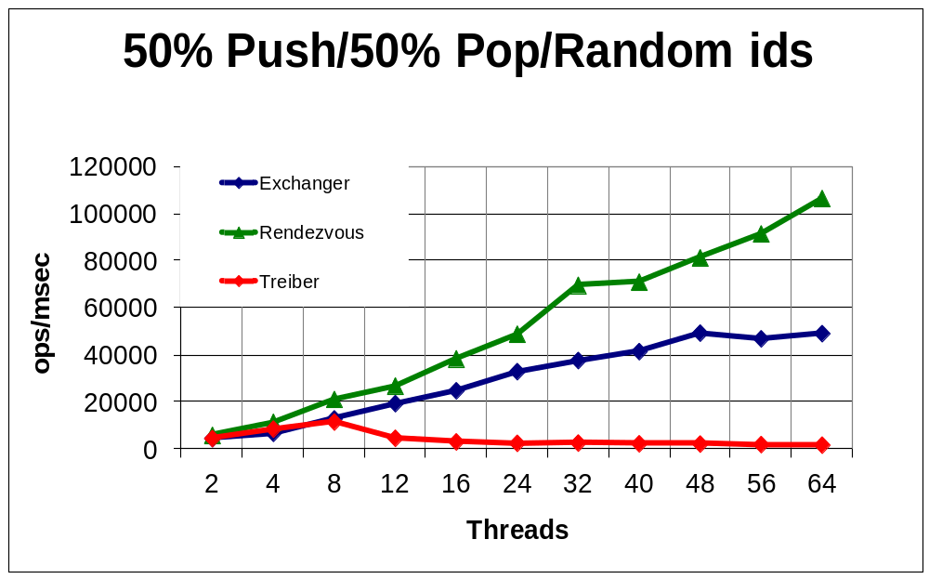
Asymmetric vs. Symmetric

Slide 116
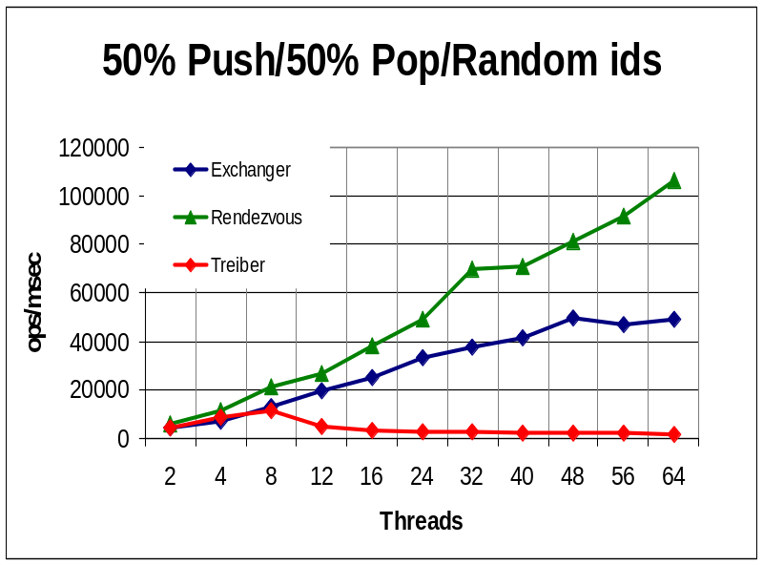
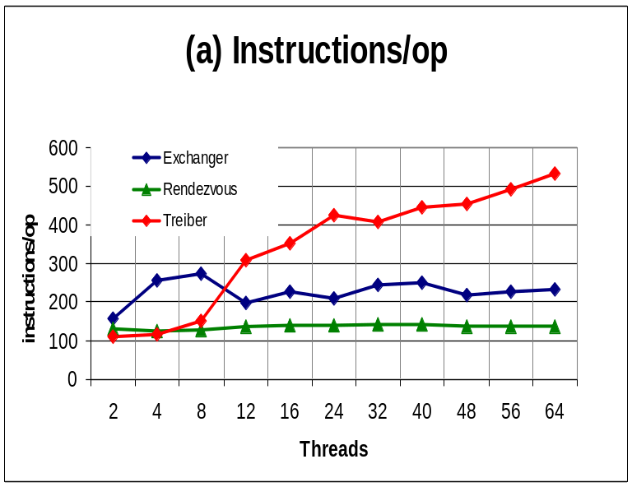
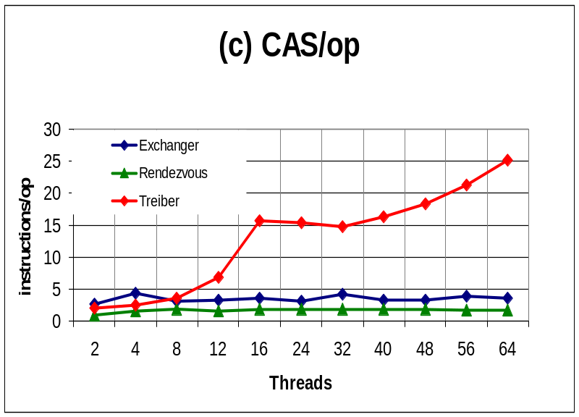
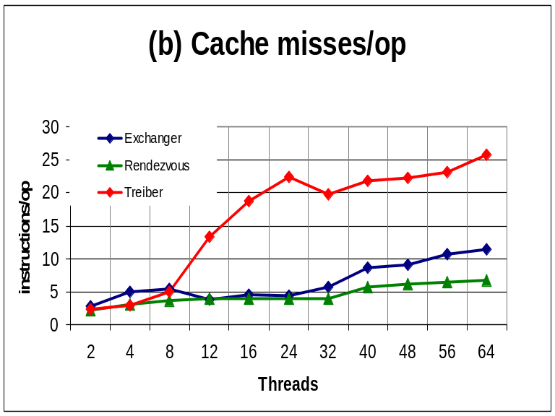

Slide 117
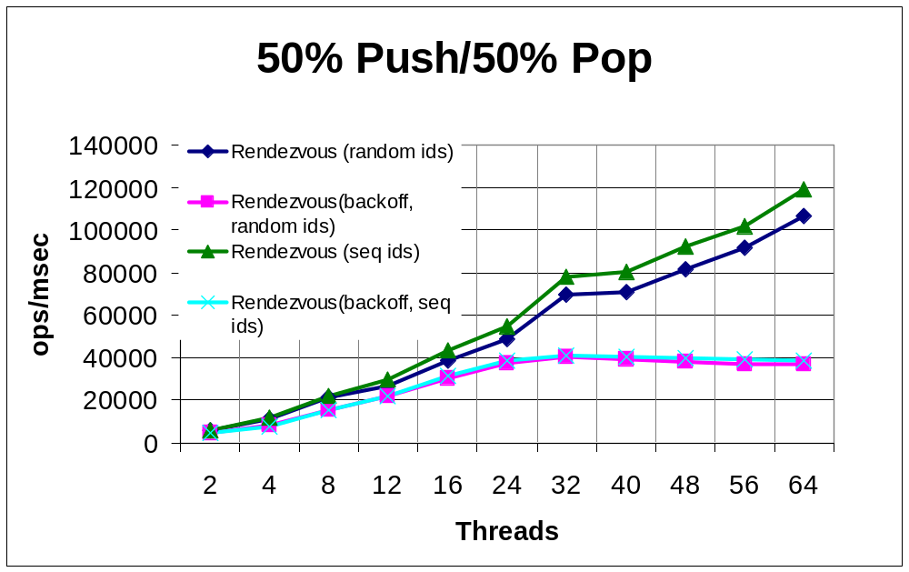
Effect of Backoff and Slot Choice

Slide 118
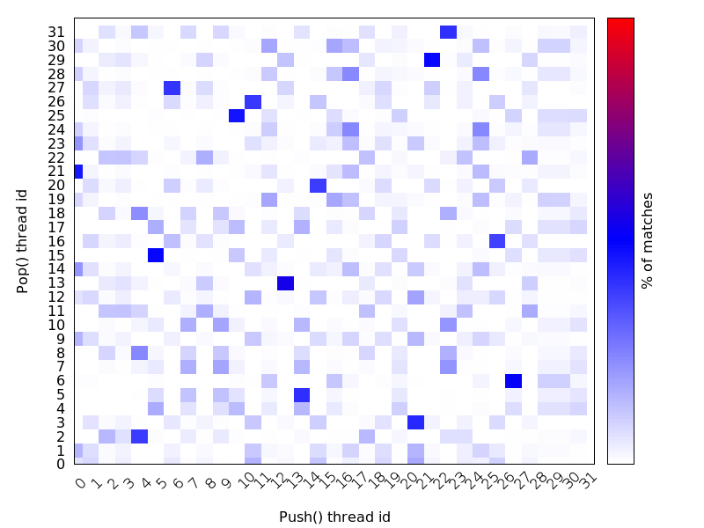
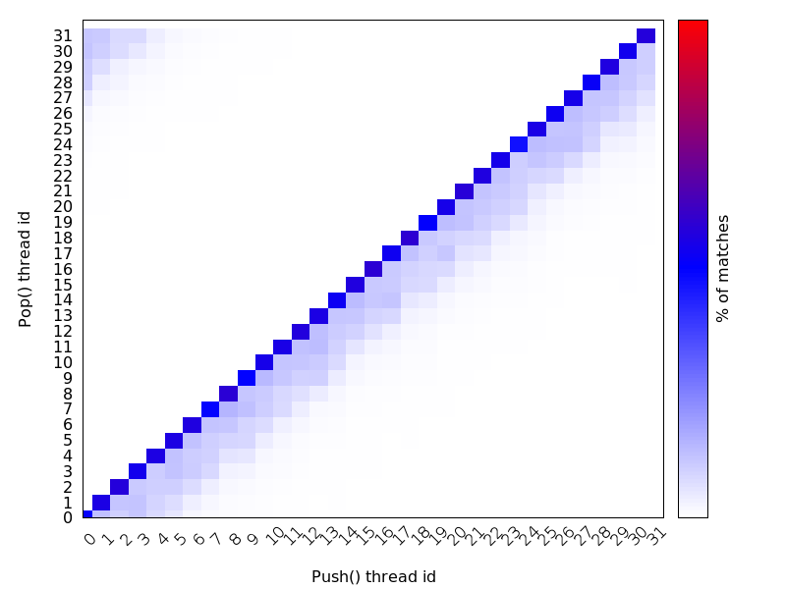
Effect of Slot Choice
Random choice Sequential choice
Darker shades mean more exchanges

Slide 119
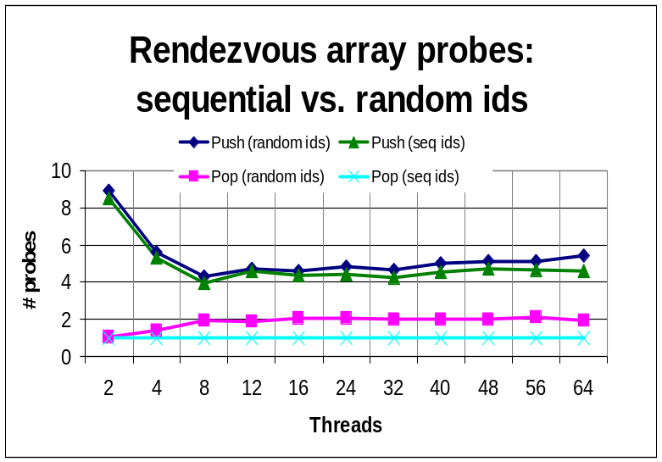
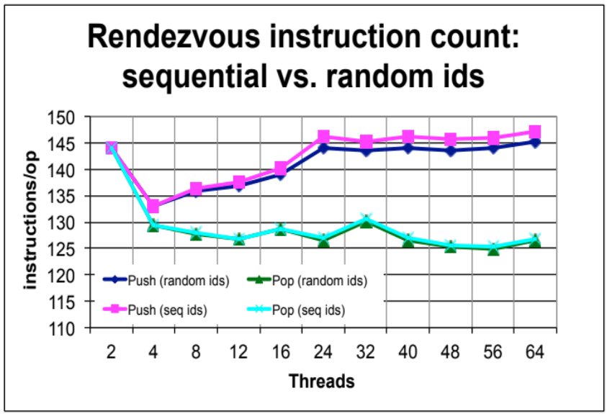
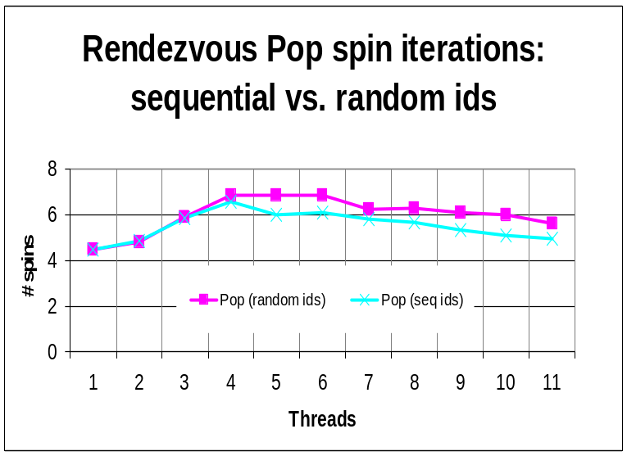
Effect of Slot Choice

Slide 120
Linearizability
Un-eliminated calls: linearized as before
Eliminated calls: linearize pop() immediately after matching push()
Combination is a linearizable stack
120
Notes:
120

Slide 121
Un-Eliminated Linearizability
linearizable
pop(v₁)
pop(v₁)
push(v₁)
push(v₁)
time
time
121
Notes:
121

Slide 122
Eliminated Linearizability
Collision
Point
linearizable
pop(v₁)
pop(v₁)
push(v₁)
push(v₁)
pop(v₂)
pop(v₂)
Red calls are
eliminated
push(v₂)
push(v₂)
time
time
122
Notes:
122

Slide 123
Backoff Has Dual Effect
Elimination introduces parallelism
Backoff to array cuts contention on lock-free stack
Elimination in array cuts down number of threads accessing lock-free stack
123
Notes:
123

Slide 124
Elimination Array
public class EliminationArray {
private static final int duration = ...;
private static final int timeUnit = ...;
Exchanger<T>[] exchanger;
public EliminationArray(int capacity) {
exchanger = new Exchanger[capacity];
for (int i = 0; i < capacity; i++)
exchanger[i] = new Exchanger<T>();
…
}
…
}
124
Notes:
124

Slide 125
Elimination Array
public class EliminationArray {
private static final int duration = ...;
private static final int timeUnit = ...;
Exchanger<T>[] exchanger;
public EliminationArray(int capacity) {
exchanger = new Exchanger[capacity];
for (int i = 0; i < capacity; i++)
exchanger[i] = new Exchanger<T>();
…
}
…
}
An array of Exchangers
125
Notes:
125

Slide 126
Digression: A Lock-Free Exchanger
public class Exchanger<T> {
AtomicStampedReference<T> slot
= new AtomicStampedReference<T>(null, 0);
126
Notes:
126

Slide 127
A Lock-Free Exchanger
public class Exchanger<T> {
AtomicStampedReference<T> slot
= new AtomicStampedReference<T>(null, 0);
Atomically modifiable reference + status
127
Notes:
127

Slide 128
Atomic Stamped Reference
Class AtomicStampedReference
Package Java.util.concurrent.atomic
reference
address
S
stamp
128
Notes:
128
The actual implementation in Java is by having an indirection through a special sentinel node. If the special node exists then the mark is set, and if the node does not, then the bit is false. The sentinel points to the desired address so we pay a level of indirection. In C, using alignment on 32 bit architectures or on 64 bit architectures, we can “steal” a bit from the pointer.

Slide 129
Extracting Reference & Stamp
public T get(int[] stampHolder);
Returns reference to object of type T
Returns stamp at array index 0!
129
Notes:
129

Slide 130
Exchange Status
enum Status {EMPTY, WAITING, BUSY};
Nothing yet
One thread is waiting for rendezvous
Other threads busy with rendezvous
130
Notes:
130

Slide 131
The Exchange
public T Exchange(T myItem, long nanos)
throws TimeoutException {
long timeBound = System.nanoTime() + nanos;
int[] stampHolder = {EMPTY};
while (true) {
if (System.nanoTime() > timeBound)
throw new TimeoutException();
T herItem = slot.get(stampHolder);
int stamp = stampHolder[0];
switch(stamp) {
case EMPTY: … // slot is free
case WAITING: … // someone waiting for me
case BUSY: … // others exchanging
}
}
131
Notes:
131

Slide 132
The Exchange
public T Exchange(T myItem, long nanos)
throws TimeoutException {
long timeBound = System.nanoTime() + nanos;
int[] stampHolder = {EMPTY};
while (true) {
if (System.nanoTime() > timeBound)
throw new TimeoutException();
T herItem = slot.get(stampHolder);
int stamp = stampHolder[0];
switch(stamp) {
case EMPTY: … // slot is free
case WAITING: … // someone waiting for me
case BUSY: … // others exchanging
}
}
Item and timeout
132
Notes:
132

Slide 133
The Exchange
public T Exchange(T myItem, long nanos)
throws TimeoutException {
long timeBound = System.nanoTime() + nanos;
int[] stampHolder = {EMPTY};
while (true) {
if (System.nanoTime() > timeBound)
throw new TimeoutException();
T herItem = slot.get(stampHolder);
int stamp = stampHolder[0];
switch(stamp) {
case EMPTY: … // slot is free
case WAITING: … // someone waiting for me
case BUSY: … // others exchanging
}
}
Array holds status
133
Notes:
133

Slide 134
The Exchange
public T Exchange(T myItem, long nanos)
throws TimeoutException {
long timeBound = System.nanoTime() + nanos;
int[] stampHolder = {EMPTY};
while (true) {
if (System.nanoTime() > timeBound)
throw new TimeoutException();
T herItem = slot.get(stampHolder);
int stamp = stampHolder[0];
switch(stamp) {
case EMPTY: … // slot is free
case WAITING: … // someone waiting for me
case BUSY: … // others exchanging
}
}
Loop until timeout
134
Notes:
134

Slide 135
The Exchange
public T Exchange(T myItem, long nanos)
throws TimeoutException {
long timeBound = System.nanoTime() + nanos;
int[] stampHolder = {EMPTY};
while (true) {
if (System.nanoTime() > timeBound)
throw new TimeoutException();
T herItem = slot.get(stampHolder);
int stamp = stampHolder[0];
switch(stamp) {
case EMPTY: … // slot is free
case WAITING: … // someone waiting for me
case BUSY: … // others exchanging
}
}
Get other’s item and status
135
Notes:
135

Slide 136
The Exchange
public T Exchange(T myItem, long nanos)
throws TimeoutException {
long timeBound = System.nanoTime() + nanos;
int[] stampHolder = {EMPTY};
while (true) {
if (System.nanoTime() > timeBound)
throw new TimeoutException();
T herItem = slot.get(stampHolder);
int stamp = stampHolder[0];
switch(stamp) {
case EMPTY: … // slot is free
case WAITING: … // someone waiting for me
case BUSY: … // others exchanging
}
}
An Exchanger has three possible states
136
Notes:
136

Slide 137
Lock-free Exchanger
EMPTY
137
Notes:
137

Slide 138
Lock-free Exchanger
CAS
EMPTY
138
Notes:
138

Slide 139
Lock-free Exchanger
WAITING
139
Notes:
139

Slide 140
Lock-free Exchanger
In search of partner …
WAITING
140
Notes:
140

Slide 141
Lock-free Exchanger
Try to exchange item and set status to BUSY
Still waiting …
Slot
CAS
WAITING
141
Notes:
141
Obviously some other thread can try and set the state to 2 also and only the winner does the exchange.

Slide 142
Lock-free Exchanger
Partner showed up, take item and reset to EMPTY
Slot
BUSY
item
status
142
Notes:
142

Slide 143
Lock-free Exchanger
Partner showed up, take item and reset to EMPTY
BUSY
EMPTY
item
status
143
Notes:
143

Slide 144
Exchanger State EMPTY
case EMPTY: // slot is free
if (slot.CAS(herItem, myItem, EMPTY, WAITING)) {
while (System.nanoTime() < timeBound){
herItem = slot.get(stampHolder);
if (stampHolder[0] == BUSY) {
slot.set(null, EMPTY);
return herItem;
}}
if (slot.CAS(myItem, null, WAITING, EMPTY)){
throw new TimeoutException();
} else {
herItem = slot.get(stampHolder);
slot.set(null, EMPTY);
return herItem;
}
} break;
144
Notes:
144
We present algorithm with timestamps so that you will not worry about possible ABA but actually can implement this scheme with counter that has just 3 values.

Slide 145
Exchanger State EMPTY
case EMPTY: // slot is free
if (slot.CAS(herItem, myItem, EMPTY, WAITING)) {
while (System.nanoTime() < timeBound){
herItem = slot.get(stampHolder);
if (stampHolder[0] == BUSY) {
slot.set(null, EMPTY);
return herItem;
}}
if (slot.CAS(myItem, null, WAITING, EMPTY)){
throw new TimeoutException();
} else {
herItem = slot.get(stampHolder);
slot.set(null, EMPTY);
return herItem;
}
} break;
Try to insert myItem and change state to WAITING
145
Notes:
145
We present algorithm with timestamps so that you will not worry about possible ABA but actually can implement this scheme with counter that has just 3 values 0,1, and 2.

Slide 146
Exchanger State EMPTY
case EMPTY: // slot is free
if (slot.CAS(herItem, myItem, EMPTY, WAITING)) {
while (System.nanoTime() < timeBound){
herItem = slot.get(stampHolder);
if (stampHolder[0] == BUSY) {
slot.set(null, EMPTY);
return herItem;
}}
if (slot.CAS(myItem, null, WAITING, EMPTY)){
throw new TimeoutException();
} else {
herItem = slot.get(stampHolder);
slot.set(null, EMPTY);
return herItem;
}
} break;
Spin until either
myItem is taken or timeout
146
Notes:
146
We present algorithm with timestamps so that you will not worry about possible ABA but actually can implement this scheme with counter that has just 3 values 0,1, and 2.

Slide 147
Exchanger State EMPTY
case EMPTY: // slot is free
if (slot.CAS(herItem, myItem, EMPTY, WAITING)) {
while (System.nanoTime() < timeBound){
herItem = slot.get(stampHolder);
if (stampHolder[0] == BUSY) {
slot.set(null, EMPTY);
return herItem;
}}
if (slot.CAS(myItem, null, WAITING, EMPTY)){
throw new TimeoutException();
} else {
herItem = slot.get(stampHolder);
slot.set(null, EMPTY);
return herItem;
}
} break;
myItem was taken,
so return herItem
that was put in its place
147
Notes:
147
We present algorithm with timestamps so that you will not worry about possible ABA but actually can implement this scheme with counter that has just 3 values 0,1, and 2.

Slide 148
Exchanger State EMPTY
case EMPTY: // slot is free
if (slot.CAS(herItem, myItem, EMPTY, WAITING)) {
while (System.nanoTime() < timeBound){
herItem = slot.get(stampHolder);
if (stampHolder[0] == BUSY) {
slot.set(null, EMPTY);
return herItem;
}}
if (slot.CAS(myItem, null, WAITING, EMPTY)){
throw new TimeoutException();
} else {
herItem = slot.get(stampHolder);
slot.set(null, EMPTY);
return herItem;
}
} break;
Otherwise we ran out of time, try to reset status to EMPTY and time out
148
Notes:
148
We present algorithm with timestamps so that you will not worry about possible ABA but actually can implement this scheme with counter that has just 3 values 0,1, and 2.

Slide 149
Exchanger State EMPTY
case EMPTY: // slot is free
if (slot.CAS(herItem, myItem, EMPTY, WAITING)) {
while (System.nanoTime() < timeBound){
herItem = slot.get(stampHolder);
if (stampHolder[0] == BUSY) {
slot.set(null, EMPTY);
return herItem;
}}
if (slot.CAS(myItem, null, WAITING, EMPTY)){
throw new TimeoutException();
} else {
herItem = slot.get(stampHolder);
slot.set(null, EMPTY);
return herItem;
}
} break;
If reset failed,
someone showed up after all, so take that item
Art of Multiprocessor Programming© Herlihy-Shavit 2007
149
Notes:
149

Slide 150
Exchanger State EMPTY
case EMPTY: // slot is free
if (slot.CAS(herItem, myItem, EMPTY, WAITING)) {
while (System.nanoTime() < timeBound){
herItem = slot.get(stampHolder);
if (stampHolder[0] == BUSY) {
slot.set(null, EMPTY);
return herItem;
}}
if (slot.CAS(myItem, null, WAITING, EMPTY)){
throw new TimeoutException();
} else {
herItem = slot.get(stampHolder);
slot.set(null, EMPTY);
return herItem;
}
} break;
Clear slot and take that item
150
Notes:
150
We present algorithm with timestamps so that you will not worry about possible ABA but actually can implement this scheme with counter that has just 3 values 0,1, and 2.

Slide 151
Exchanger State EMPTY
case EMPTY: // slot is free
if (slot.CAS(herItem, myItem, EMPTY, WAITING)) {
while (System.nanoTime() < timeBound){
herItem = slot.get(stampHolder);
if (stampHolder[0] == BUSY) {
slot.set(null, EMPTY);
return herItem;
}}
if (slot.CAS(myItem, null, WAITING, EMPTY)){
throw new TimeoutException();
} else {
herItem = slot.get(stampHolder);
slot.set(null, EMPTY);
return herItem;
}
} break;
If initial CAS failed,
then someone else changed status from EMPTY to WAITING,
so retry from start
151
Notes:
151
We present algorithm with timestamps so that you will not worry about possible ABA but actually can implement this scheme with counter that has just 3 values 0,1, and 2.

Slide 152
States WAITING and BUSY
case WAITING: // someone waiting for me
if (slot.CAS(herItem, myItem, WAITING, BUSY))
return herItem;
break;
case BUSY: // others in middle of exchanging
break;
default: // impossible
break;
}
}
}
}
152
Notes:
152

Slide 153
States WAITING and BUSY
case WAITING: // someone waiting for me
if (slot.CAS(herItem, myItem, WAITING, BUSY))
return herItem;
break;
case BUSY: // others in middle of exchanging
break;
default: // impossible
break;
}
}
}
}
Someone is waiting to exchange,
so try to CAS my item in
and change state to BUSY
153
Notes:
153

Slide 154
States WAITING and BUSY
case WAITING: // someone waiting for me
if (slot.CAS(herItem, myItem, WAITING, BUSY))
return herItem;
break;
case BUSY: // others in middle of exchanging
break;
default: // impossible
break;
}
}
}
}
If successful, return other’s item,
otherwise someone else took it,
so try again from start
154
Notes:
154

Slide 155
States WAITING and BUSY
case WAITING: // someone waiting for me
if (slot.CAS(herItem, myItem, WAITING, BUSY))
return herItem;
break;
case BUSY: // others in middle of exchanging
break;
default: // impossible
break;
}
}
}
}
If BUSY,
other threads exchanging,
so start again
155
Notes:
155

Slide 156
The Exchanger Slot
Exchanger is lock-free
An exchange can fail only if others repeatedly succeeded or no-one showed up
We do not require symmetric exchange
156
Notes:
156
Notice that The slot we need does not require symmetric exchange, only push needs to pass item to pop.

Slide 157
Back to the Stack: the Elimination Array
public class EliminationArray {
…
public T visit(T value, int range)
throws TimeoutException {
int slot = random.nextInt(range);
int nanodur = convertToNanos(duration, timeUnit));
return (exchanger[slot].exchange(value, nanodur)
}}
157
Notes:
157

Slide 158
Elimination Array
public class EliminationArray {
…
public T visit(T value, int range)
throws TimeoutException {
int slot = random.nextInt(range);
int nanodur = convertToNanos(duration, timeUnit));
return (exchanger[slot].exchange(value, nanodur)
}}
visit the elimination array
with fixed value and range
158
Notes:
158

Slide 159
Elimination Array
public class EliminationArray {
…
public T visit(T value, int range)
throws TimeoutException {
int slot = random.nextInt(range);
int nanodur = convertToNanos(duration, timeUnit));
return (exchanger[slot].exchange(value, nanodur)
}}
Pick a random array entry
159
Notes:
159

Slide 160
Elimination Array
public class EliminationArray {
…
public T visit(T value, int range)
throws TimeoutException {
int slot = random.nextInt(range);
int nanodur = convertToNanos(duration, timeUnit));
return (exchanger[slot].exchange(value, nanodur)
}}
Exchange value or time out
160
Notes:
160

Slide 161
Elimination Stack Push
public void push(T value) {
...
while (true) {
if (tryPush(node)) {
return;
} else try {
T otherValue =
eliminationArray.visit(value,policy.range);
if (otherValue == null) {
return;
}
}
161
Notes:
161

Slide 162
Elimination Stack Push
public void push(T value) {
...
while (true) {
if (tryPush(node)) {
return;
} else try {
T otherValue =
eliminationArray.visit(value,policy.range);
if (otherValue == null) {
return;
}
}
First, try to push
162
Notes:
162

Slide 163
Elimination Stack Push
public void push(T value) {
...
while (true) {
if (tryPush(node)) {
return;
} else try {
T otherValue =
eliminationArray.visit(value,policy.range);
if (otherValue == null) {
return;
}
}
If I failed, backoff & try to eliminate
Art of Multiprocessor Programming
163
163
Notes:
163
163

Slide 164
Elimination Stack Push
public void push(T value) {
...
while (true) {
if (tryPush(node)) {
return;
} else try {
T otherValue =
eliminationArray.visit(value,policy.range);
if (otherValue == null) {
return;
}
}
Value pushed and range to try
164
Notes:
164

Slide 165
Elimination Stack Push
public void push(T value) {
...
while (true) {
if (tryPush(node)) {
return;
} else try {
T otherValue =
eliminationArray.visit(value,policy.range);
if (otherValue == null) {
return;
}
}
Only pop() leaves null,
so elimination was successful
165
Notes:
165

Slide 166
Elimination Stack Push
public void push(T value) {
...
while (true) {
if (tryPush(node)) {
return;
} else try {
T otherValue =
eliminationArray.visit(value,policy.range);
if (otherValue == null) {
return;
}
}
Otherwise, retry push()on lock-free stack
166
Notes:
166

Slide 167
Elimination Stack Pop
public T pop() {
...
while (true) {
if (tryPop()) {
return value;
} else
try {
T otherValue =
eliminationArray.visit(null, policy.range;
if (otherValue != null) {
return otherValue;
}
}
}}
167
Notes:
167

Slide 168
Elimination Stack Pop
public T pop() {
...
while (true) {
if (tryPop()) {
return value;
} else
try {
T otherValue =
eliminationArray.visit(null,policy.range;
if (otherValue != null) {
return otherValue;
}
}
}}
If value not null, other thread is a push(),
so elimination succeeded
168
Notes:
168

Slide 169

Lock-based & lock-free queues & Stacks
Some inherently “sequential” data structures aren’t!
Beware ABA!
169
Notes:
169
In the worst case one can prove that n concurrent stack accesses must take omega(n) time if one takes into account the stalls caused when one thread waits for another to complete its stack access.

Slide 170
This work is licensed under a Creative Commons Attribution-ShareAlike 2.5 License.
You are free:
  to Share — to copy, distribute and transmit the work
  to Remix — to adapt the work
Under the following conditions:
  Attribution. You must attribute the work to “The Art of Multiprocessor Programming” (but not in any way that suggests that the authors endorse you or your use of the work).
  Share Alike. If you alter, transform, or build upon this work, you may distribute the resulting work only under the same, similar or a compatible license.
For any reuse or distribution, you must make clear to others the license terms of this work. The best way to do this is with a link to
  http://creativecommons.org/licenses/by-sa/3.0/.
Any of the above conditions can be waived if you get permission from the copyright holder.
Nothing in this license impairs or restricts the author's moral rights.
170
Notes:
170

Slide 171
Lock-based & lock-free queues & Stacks
Some inherently “sequential” data structures aren’t!
Beware ABA!
Elimination in array cuts down number of threads accessing lock-free stack

Slide 172
The enq() method
Increments only
Cares only if value is capacity
The deq() method
Decrements only
Cares only if value is zero
Disadvantages:
which properties are important
Must tune fairness parameters

